Slide 1
Express
www.expressjs.com

Slide 2
Express
Fast, unopinionated, minimalist web framework for Node.js
Very popular for web application development
Very flexible in terms of using and extending

Slide 3
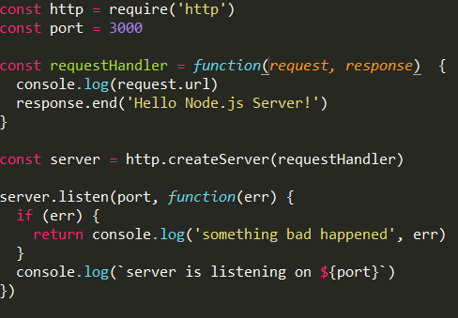
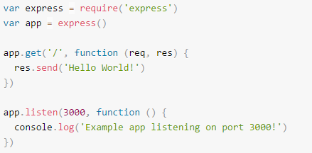
Express
npm install –save
app.js
node app.js

Slide 4
Express
“app “ is an instance of express (http server)
“app” is an abstraction of whole http server + configuration.

Slide 5
Features
routing
middleware
views
error Handling

Slide 6
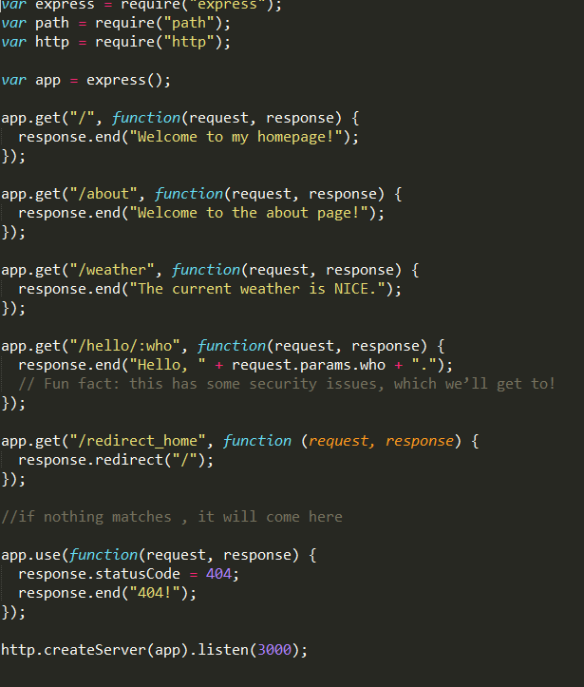
Routing

Slide 7
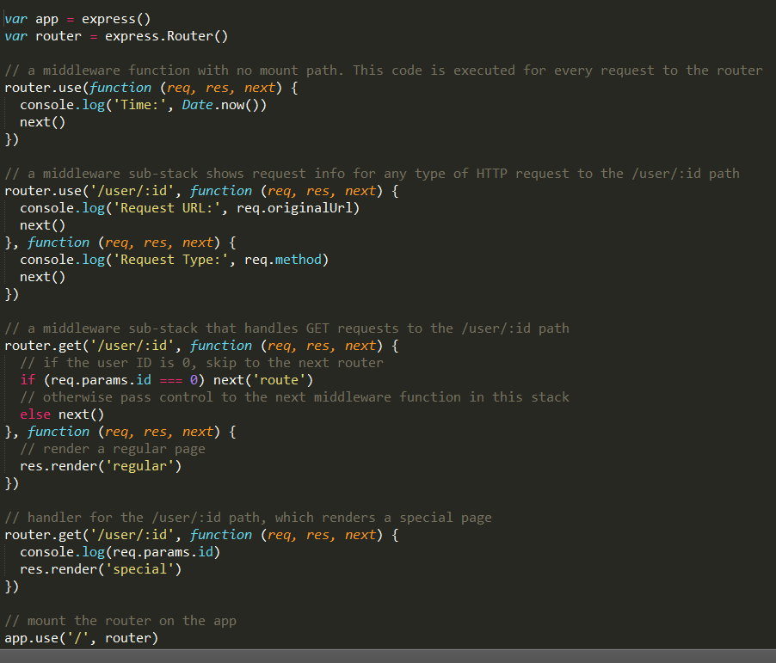
Router
Express.Router()

Slide 8
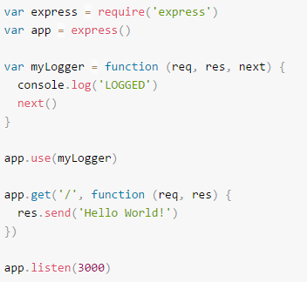
middleware
Access to request ,response
End the request-reponse cycle
Call the next middleware
Ordering is very important.

Slide 9
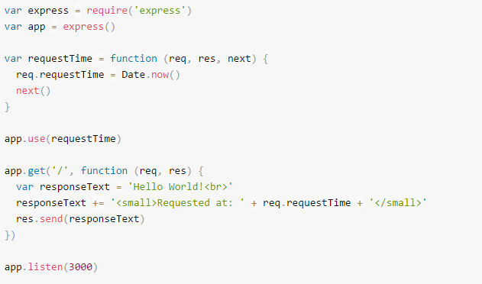
middleware

Slide 10
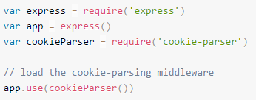
Third party middleware
Cookie-parser
Morgan
Body-parser
Express-session
npm install cookie-parser
It parses cookie and stores req.cookies

Slide 11
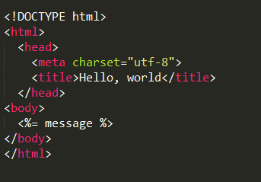
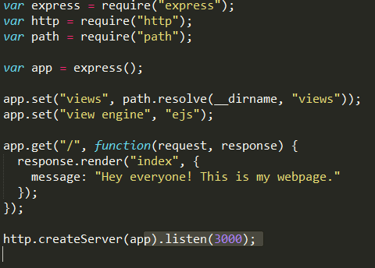
views
Configure the app to set ‘view engine’ and views ‘path’.
App.js views/index.ejs

Slide 12
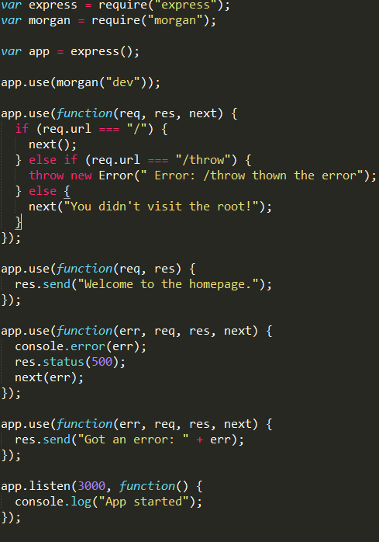
Error Handling -
Error Handling middleware

